Slide 1
Annotation tool
failure dataset

Slide 2
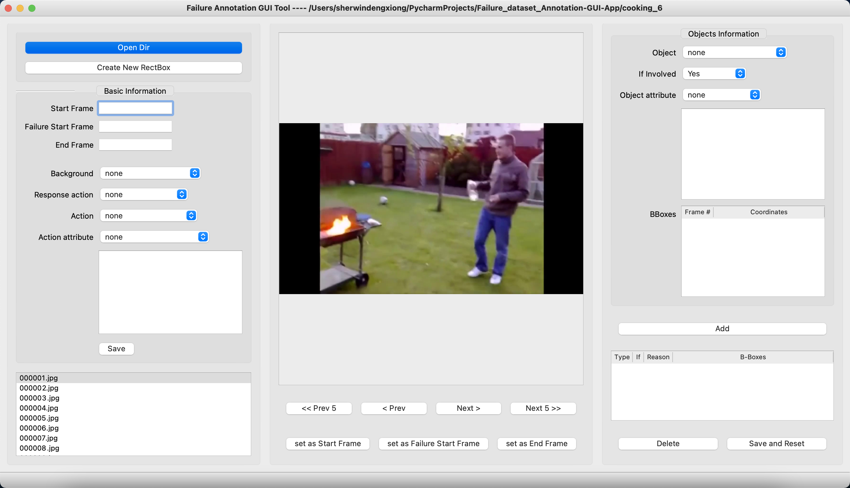
Choose the folder that contains frames
Basic information for this video.
You need to set the start frame, failure start frame and the end frame.
Then choose the background, response action, action and action attribute.
You can set the start and end frame by clicking following buttons

Slide 3
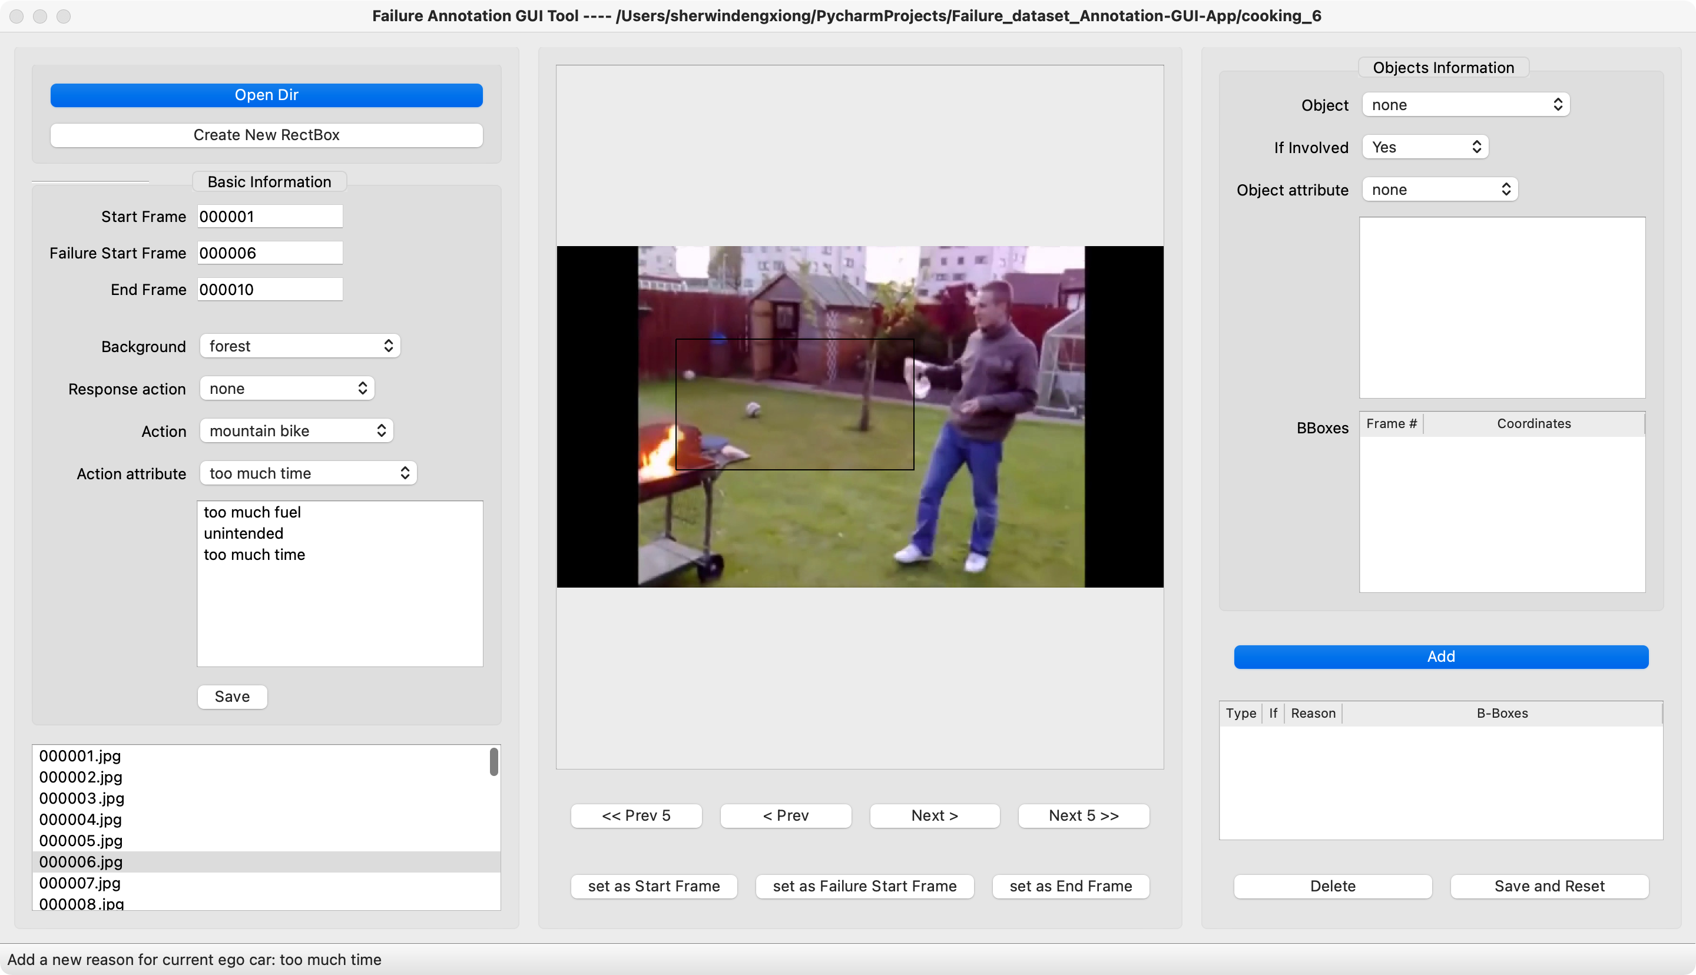
You can choose different attribute of the action. Even if it is not the correct reason for this failure.

Slide 4
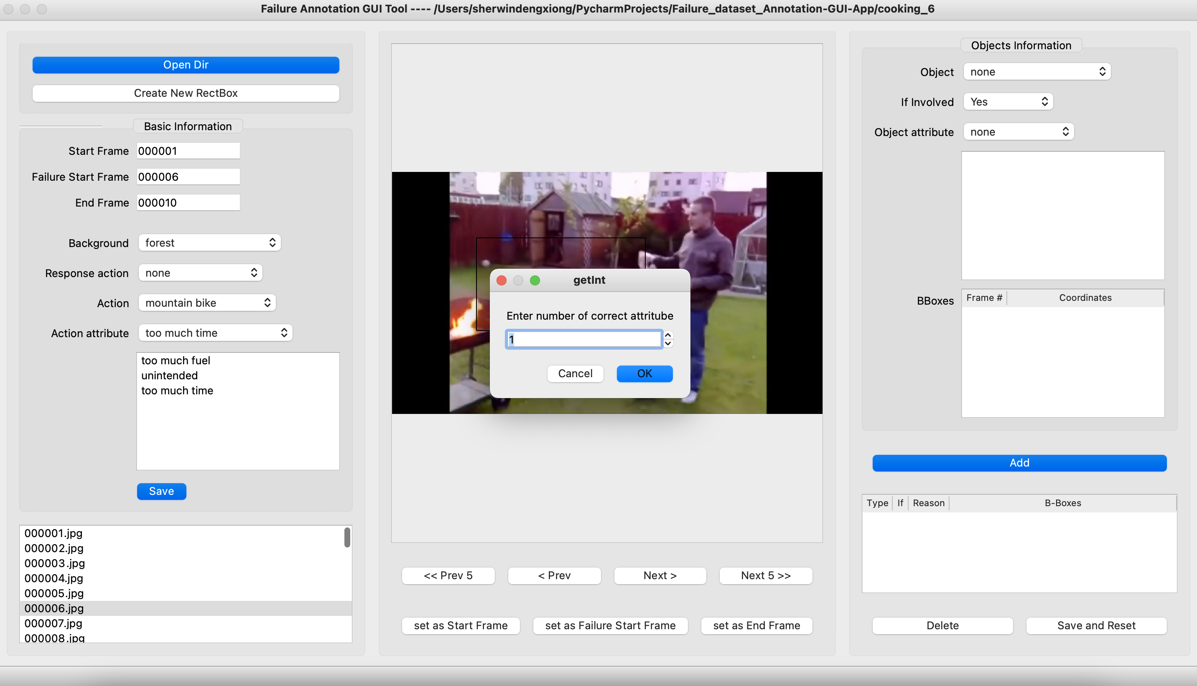
Once you click save button, you need to choose the number of correct reasons from attributes. And then you need to choose the correct reason from your attributes

Slide 5

Your attributes will list here.
If you have multiple correct reasons. This dialog will show up again.

Slide 6
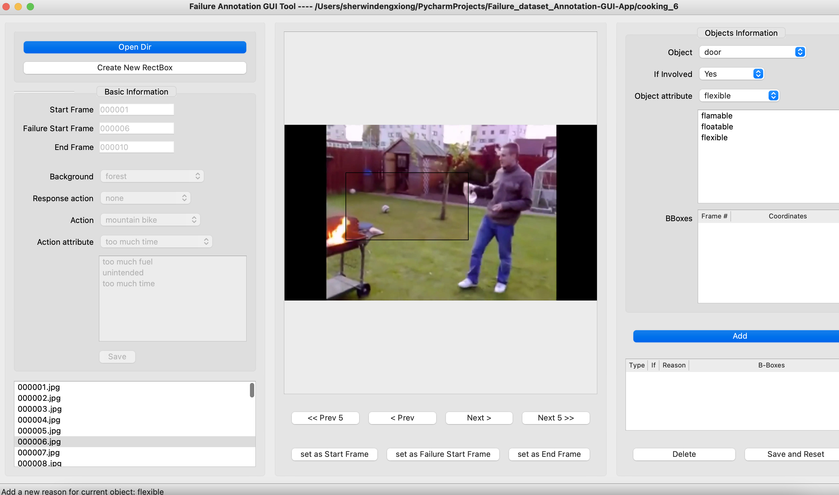
Similar to the action attributes. You can choose multiple attributes of object. Even if it is not the reason for this failure.

Slide 7
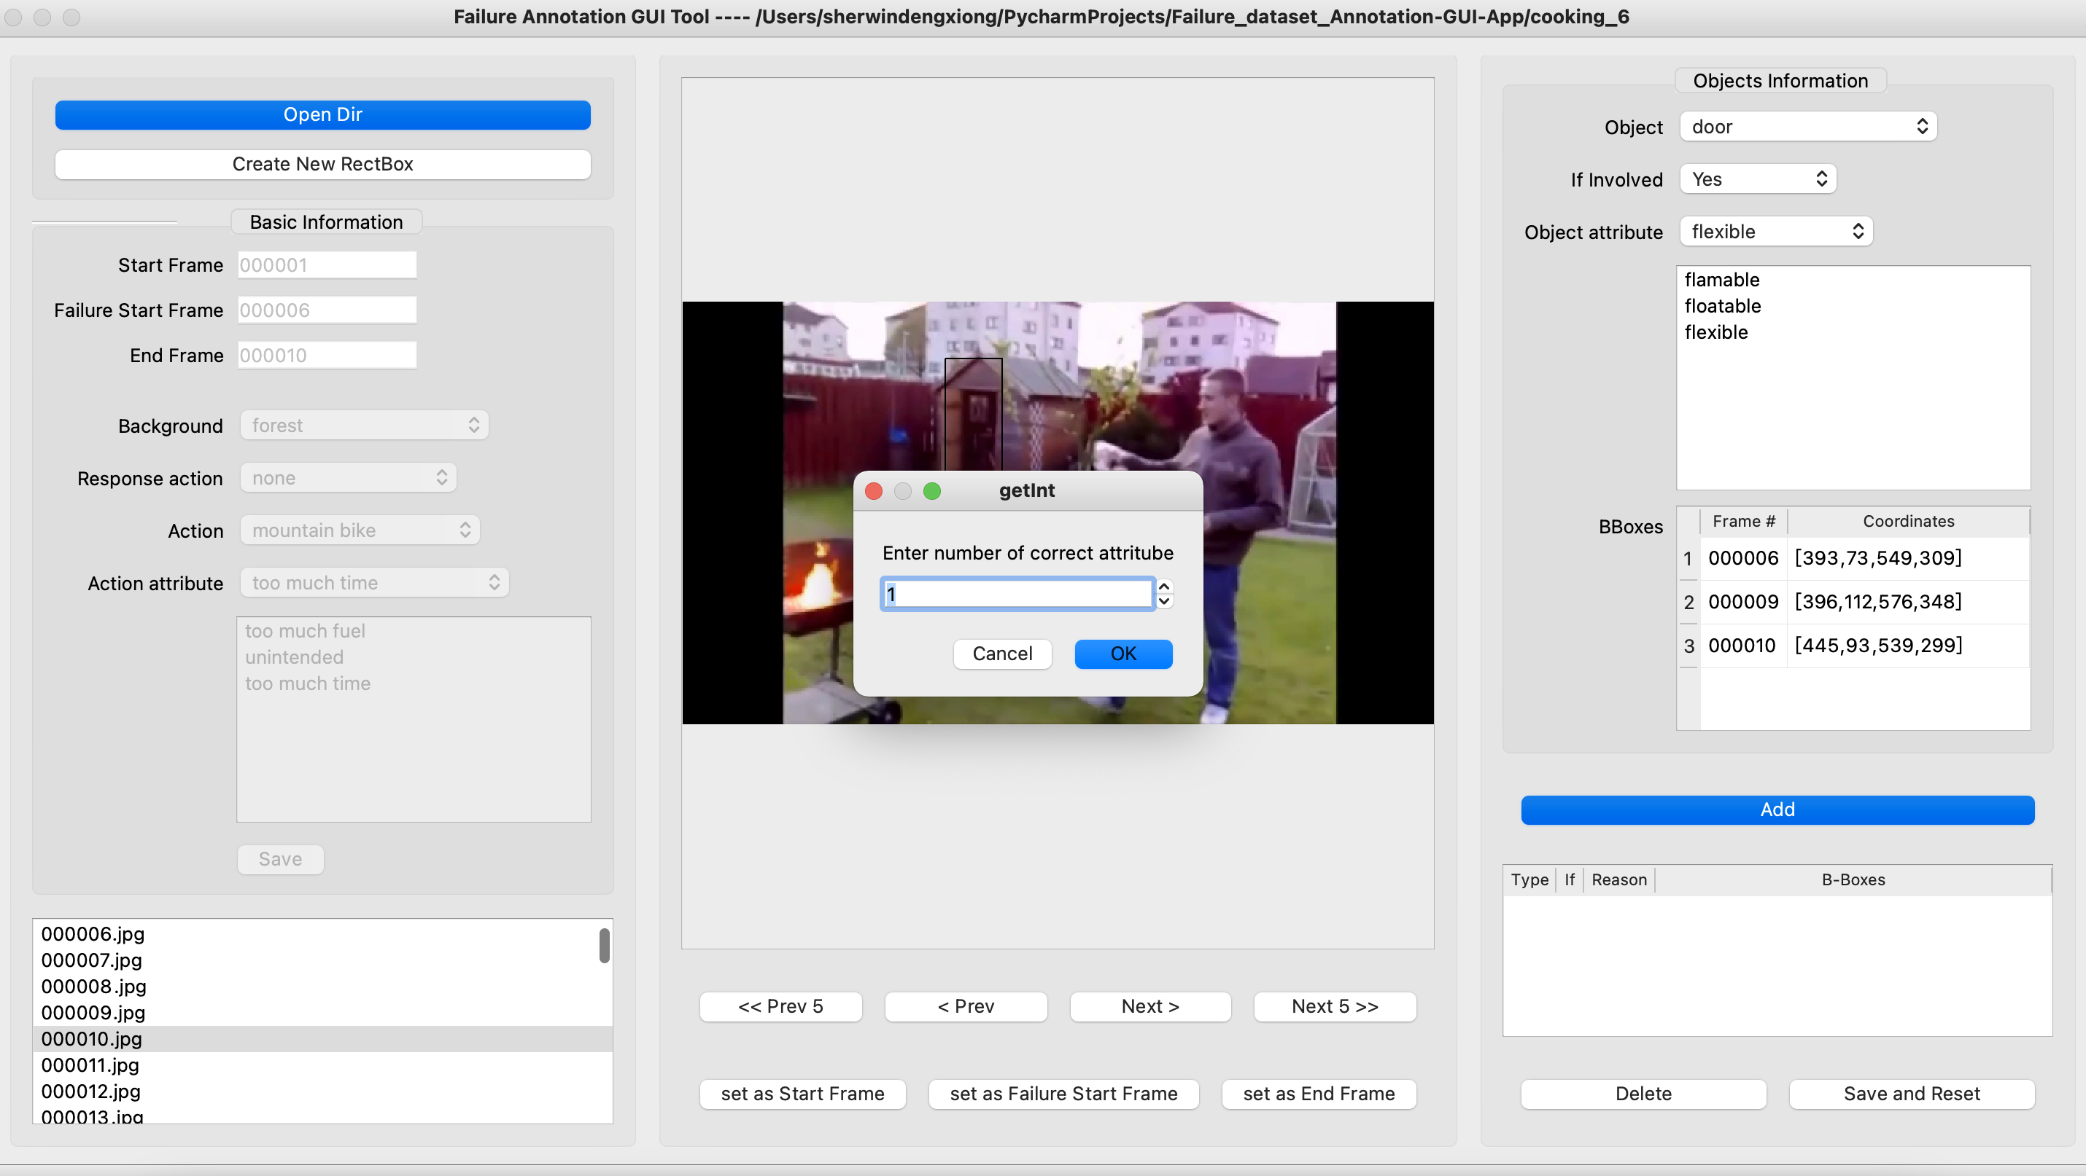
After creating bounding boxes for three frames, click the add button and select the number of correct reasons.

Slide 8
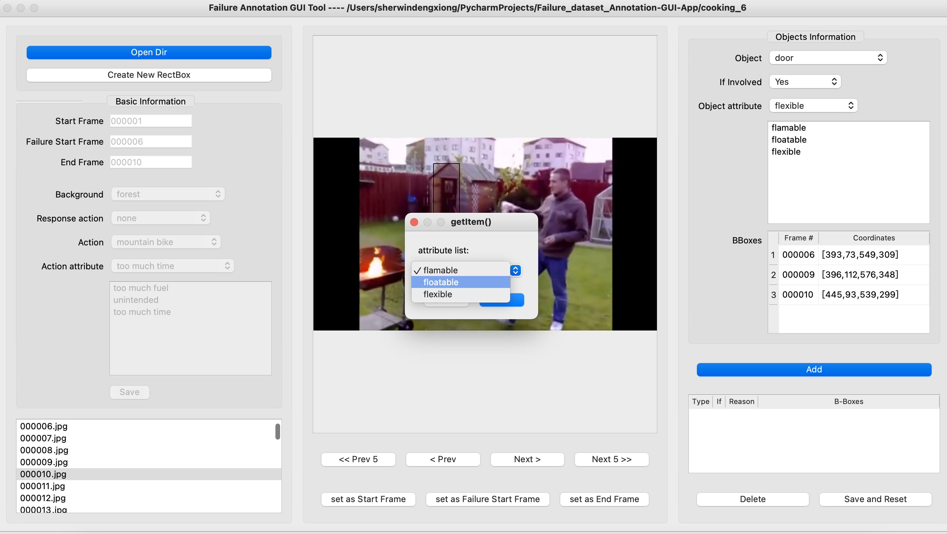
Attributes of objects will show here. Choose the correct reason from attributes

Slide 9
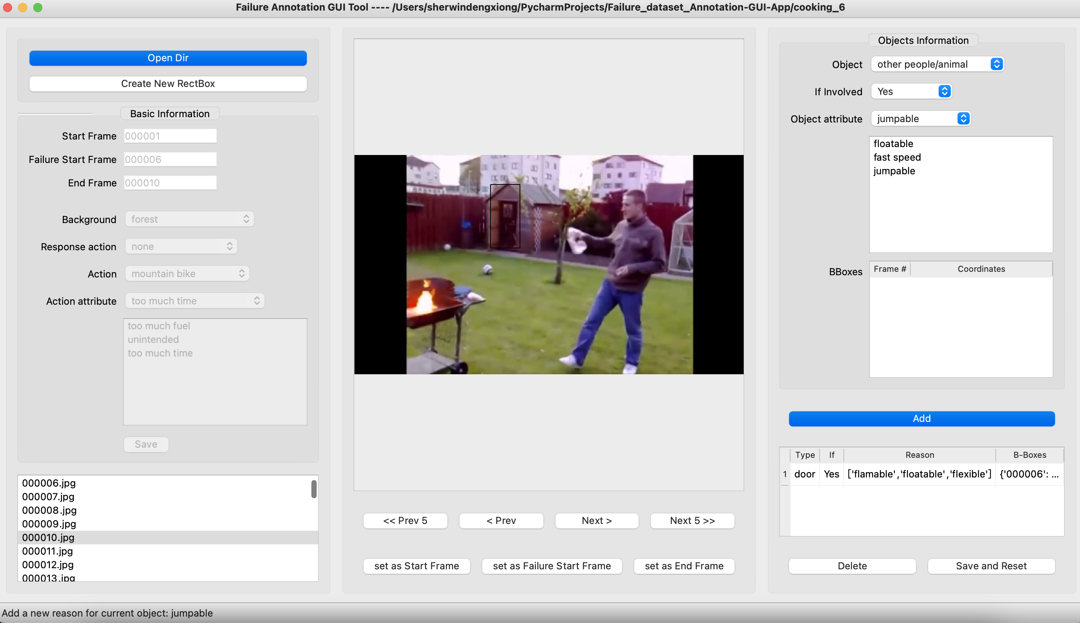
If you do not complete bounding box for three frames. The object information will not be saved.

Slide 10
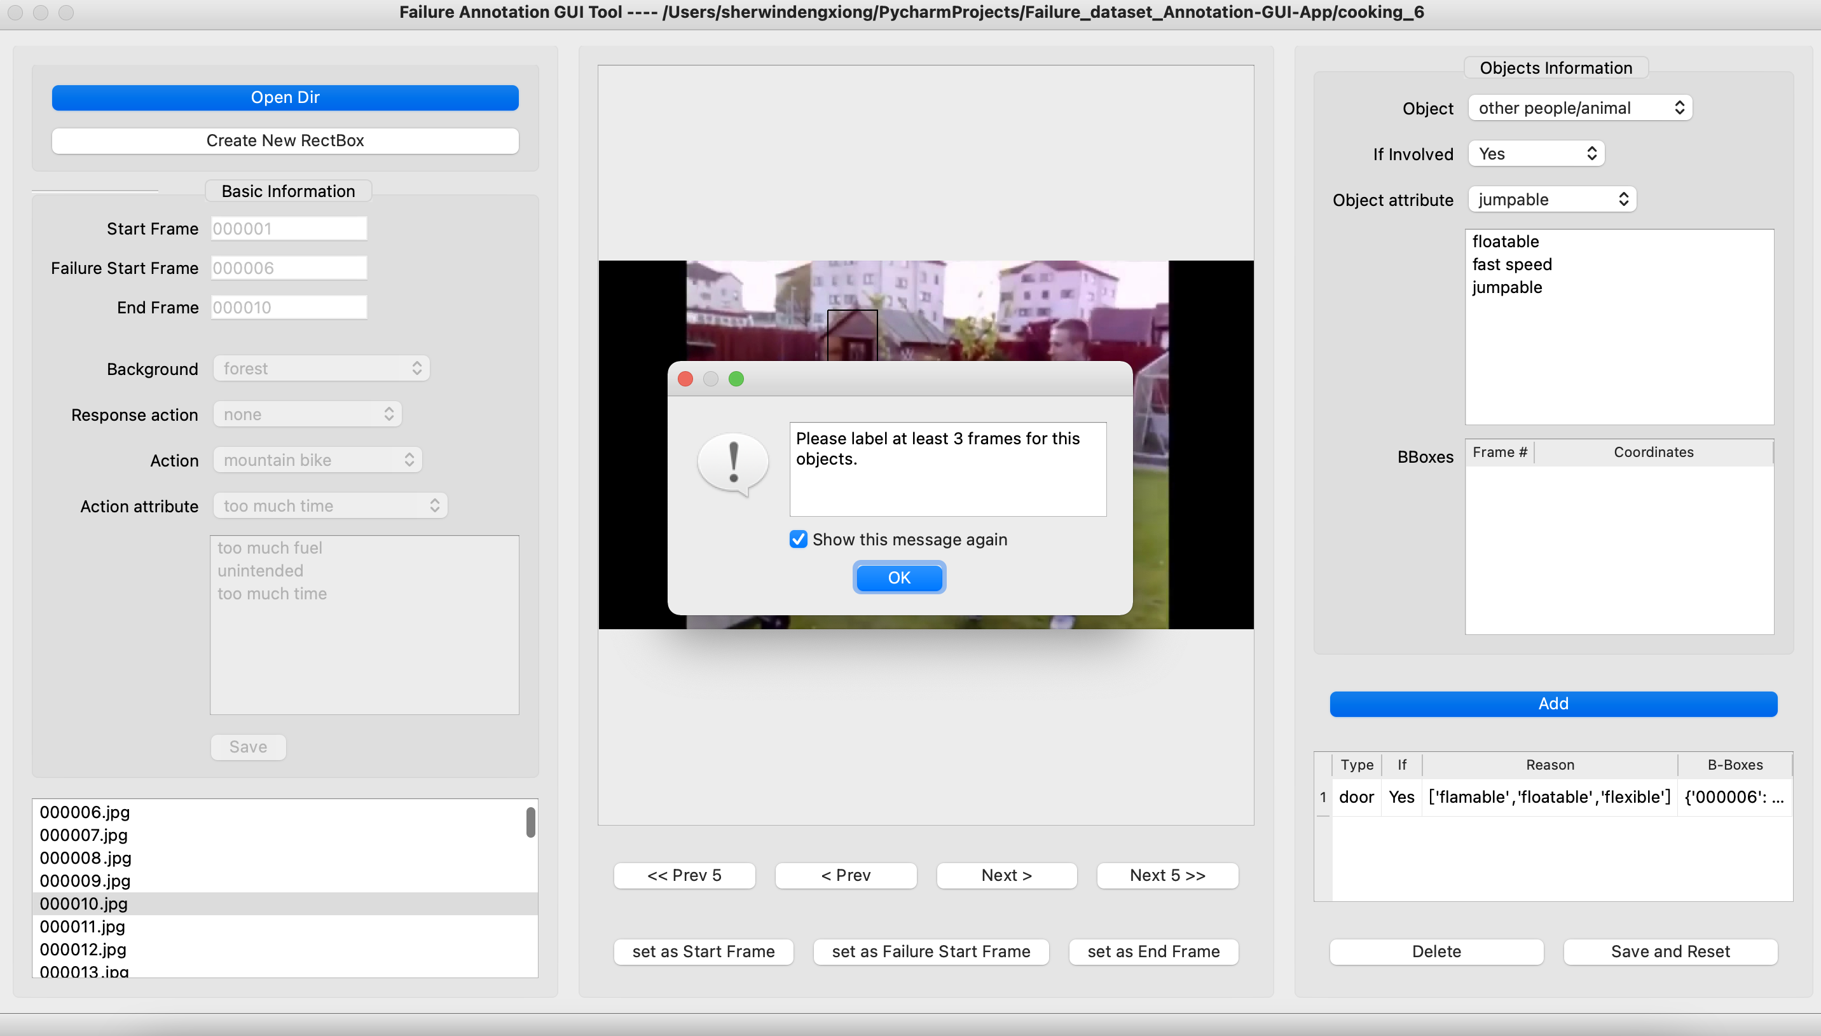
You need to create bounding box for three frames.

Slide 11
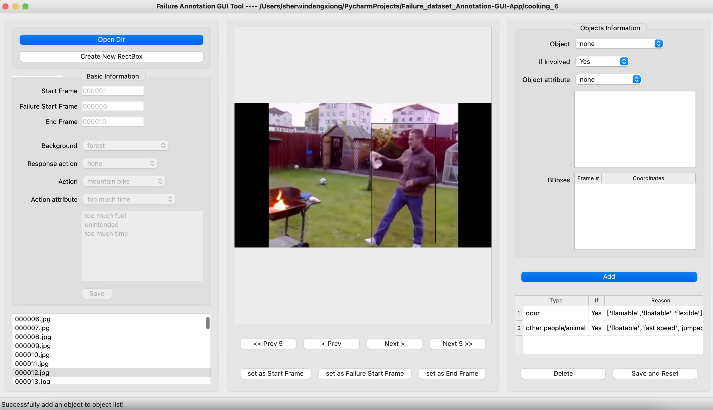
Then you can save the information.

